Slide 1


PROMPT DEFECT
A Prompt-Based Anomaly Detection System
VAND 3.0 Challenge MVTEC AD 2 Dataset Unsupervised Anomaly Detection and Localization in Industrial Products

Slide 2

About us
Muhammad Taha Mustafa 22K-8735
Saad Shuraim Rashid 22K-4108
Sharique Shah Lakhani 22K-8712
Muhammad Arish khan 22K-4118

Slide 3
Objective
Develop an unsupervised anomaly detection model using MVTEC AD 2.Identify and localize defects in industrial products. Model trained solely on normal images, evaluated on a mix of normal and anomalous images.

Slide 4
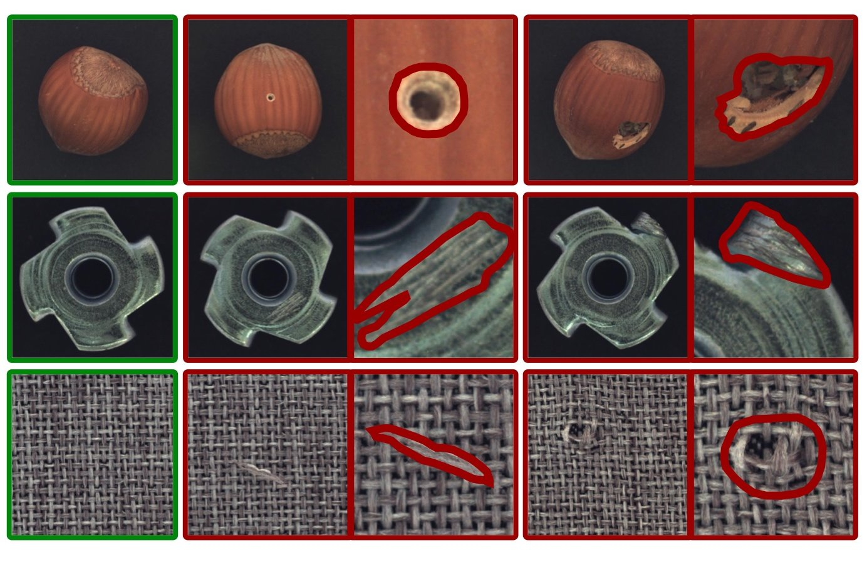
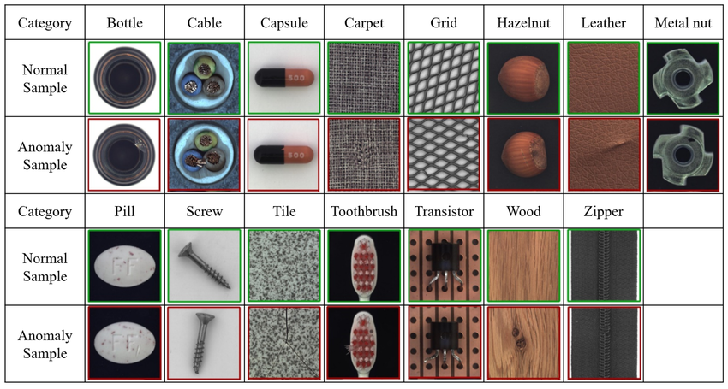
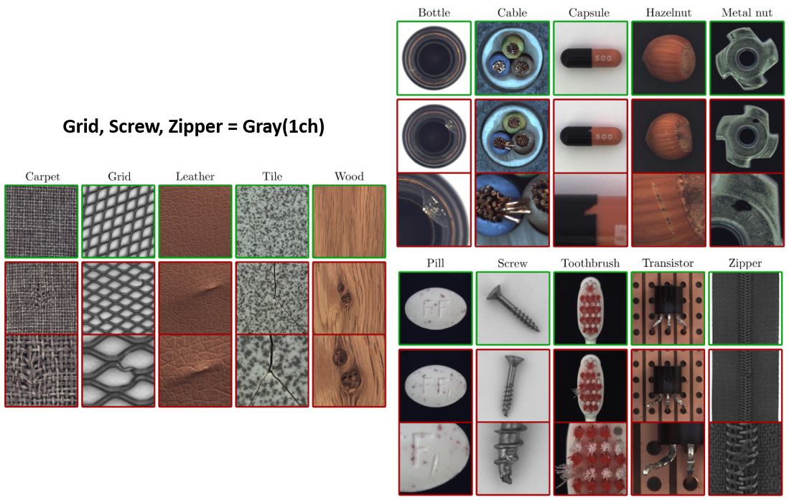
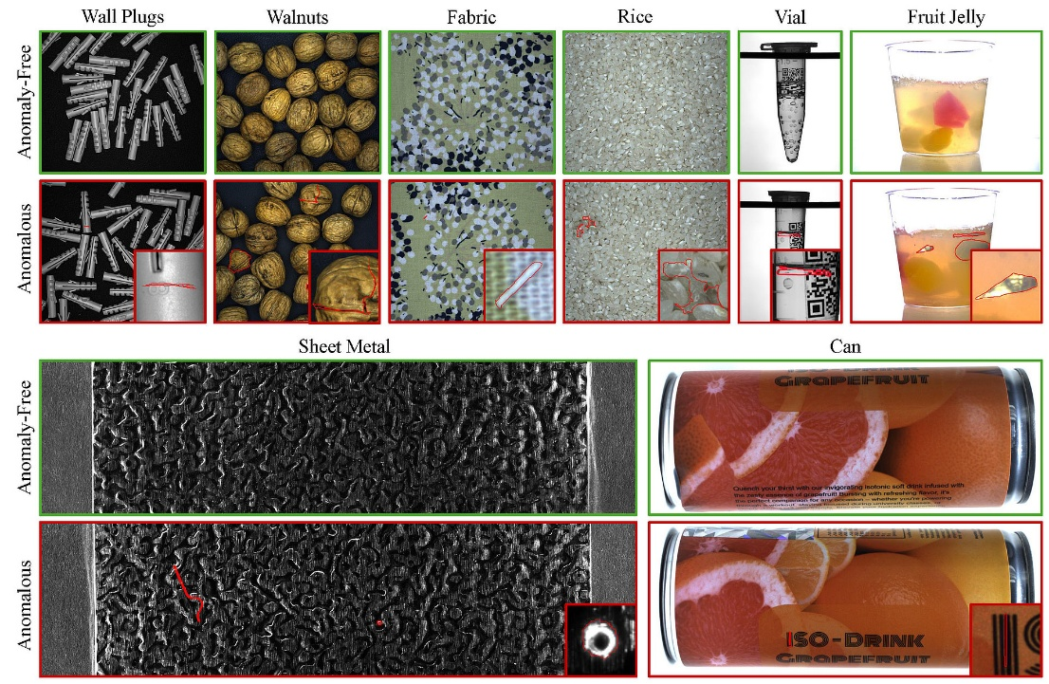
Dataset Overeviw

Slide 5

Approach
Prompt-Based Anomaly Detection (PromptAD) leverages CLIP model embeddings to detect anomalies in visual data.
Introduces learned prompts that guide the anomaly detection process by emphasizing anomaly-specific features.
Combines contrastive loss, localization head, and prompt alignment to enhance detection accuracy and feature understanding.

Slide 6
Approach
Key Components
CLIP Vision Model: Encodes images into feature space.
Vision Prompt Learner: Learns anomaly-specific prompts.
Anomaly Localization Head: Generates spatial anomaly maps.
Loss Functions:
Contrastive Prompt Loss
EAM (Embedding Alignment Margin) Loss
Prompt Alignment Loss
Dice Loss (for pixel-level localization)
BCE Loss (for anomaly score)

Slide 7
Visualization
Visualizing Anomaly Maps
The model generates anomaly maps showing areas where anomalies are most likely.
Example: Visuals from the MVTec dataset displaying:
Input image
Generated anomaly map
Ground truth mask
Image Transformation: Uses augmented transformations (e.g., rotation, color jitter) for robustness.
Key Insights
Anomaly scores and localization maps help in identifying specific defects in categories like "bottle," "cable," etc.
Visualization of the output anomaly maps provides insights into the spatial extent of anomalies.

Slide 8
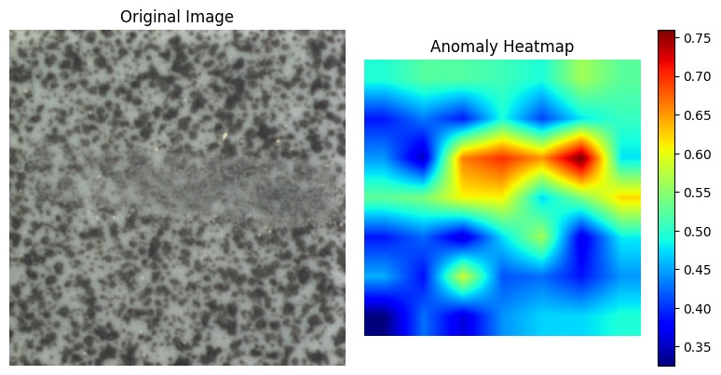
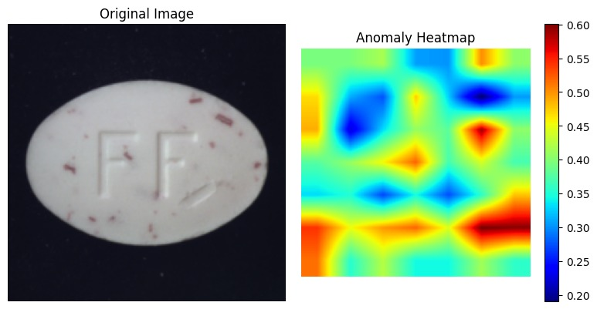
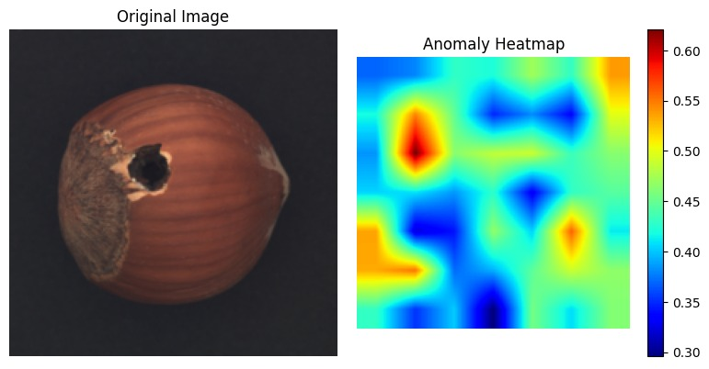
Visualization

Slide 9
Limitations
Challenges in Implementation
Limited Dataset: Dependent on the availability of high-quality labeled datasets like MVTec, restricting generalization.
Contextual Anomalies: Difficulty in detecting anomalies outside the predefined defect categories.
Computation: GPU-intensive processing due to large models (e.g., CLIP) and the high number of parameters in the prompt learning mechanism.
Fine-tuning: Hyperparameter tuning (like lambda values) can be tedious for optimal performance.
Real-Time Use
Anomalies detected might be context-dependent, requiring further validation.

Slide 10
Real-World Applications
Challenges in Implementation
Limited Dataset: Dependent on the availability of high-quality labeled datasets like MVTec, restricting generalization.
Contextual Anomalies: Difficulty in detecting anomalies outside the predefined defect categories.
Computation: GPU-intensive processing due to large models (e.g., CLIP) and the high number of parameters in the prompt learning mechanism.
Fine-tuning: Hyperparameter tuning (like lambda values) can be tedious for optimal performance.
Real-Time Use
Anomalies detected might be context-dependent, requiring further validation.

Slide 11
Key Components:
Prompt-Based Anomaly Detection (PromptAD) leverages CLIP model embeddings to detect anomalies in visual data.
Introduces learned prompts that guide the anomaly detection process by emphasizing anomaly-specific features.
Combines contrastive loss, localization head, and prompt alignment to enhance detection accuracy and feature understanding.

Slide 12
Pixel-Level Localization: Accurate segmentation of defective regions.
Robustness Assessment: Ensuring performance across varied test scenarios.

Slide 13
EVALUATION METRICS
Segmentation F1 Score (SegF1): Balance between precision and recall in pixel-level anomaly detection.
Image AUC : For global image anomaly detection.

Slide 14
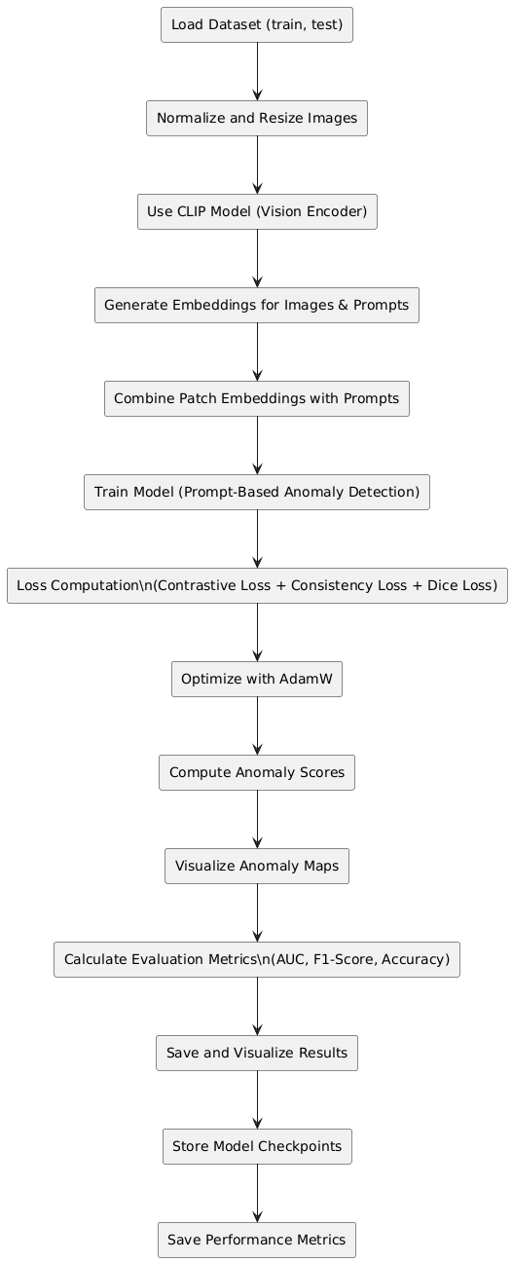
OUR APPROACH

Slide 15
Results
Metrics
Overall Performance:
Average Image-level AUC: 85.4%
Pixel-level AUC: 83.2%
Category Performance:
Example: Bottle category detection performance with F1-score, Pixel AUC, ROC-AUC.
Anomaly Detection
Normal Class: True positives identified with minimal false positives.
Defective Class: High precision and recall, especially with specific defects like "dented" or "scratched."

Slide 16
Challenges
Real-World Variability: Handling diverse lighting, transparency, and overlapping objects.
Extremely Small Defects: Detecting subtle anomalies occupying small regions.
Unsupervised Learning: Learning from normal images without any prior defect information.

Slide 17
Conclusion
Summary
PromptAD is an innovative approach for anomaly detection, utilizing CLIP-based embeddings and learned prompts to detect and localize defects in images.
Our model achieves high accuracy in detecting visual anomalies across multiple categories.
Future Work
Expanding to handle more complex anomaly types (e.g., rare defects).
Optimizing for real-time detection in resource-constrained environments.
Key Takeaways
Strong performance in industrial and medical anomaly detection.
Promising avenue for research in self-supervised learning and zero-shot anomaly detection.

Slide 18
Arowwai Industries
THANK YOU!
FOR YOUR ATTENTION
www.reallygreatsite.com

